Slide 1


Slide 2
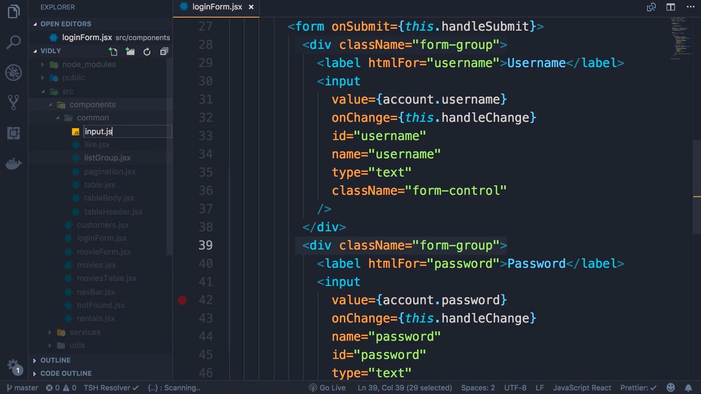
Similar code for username and password so lets extract

Slide 3
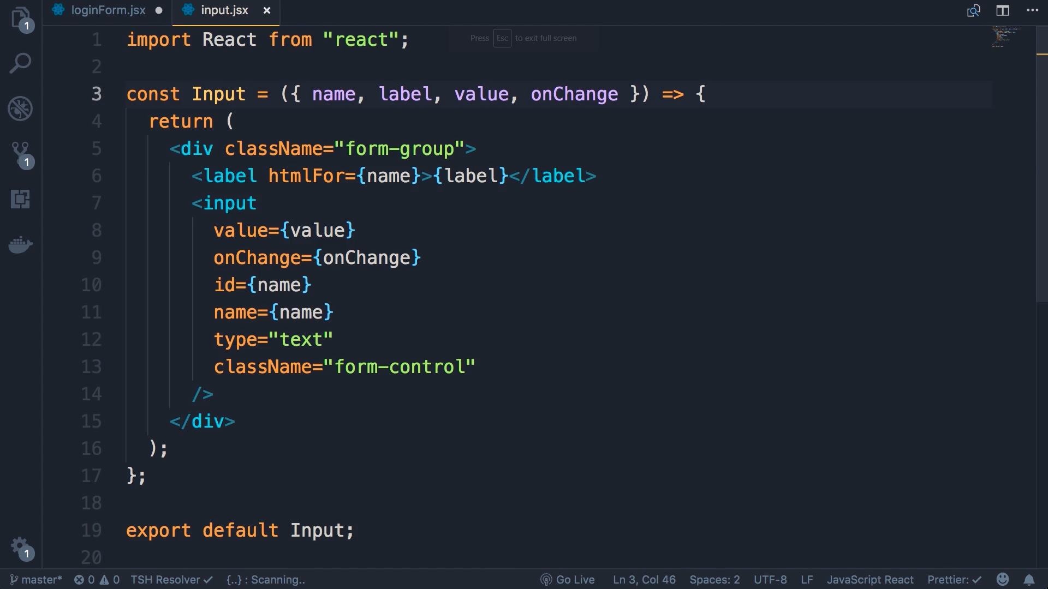
Create input.jsx in common folder

Slide 4
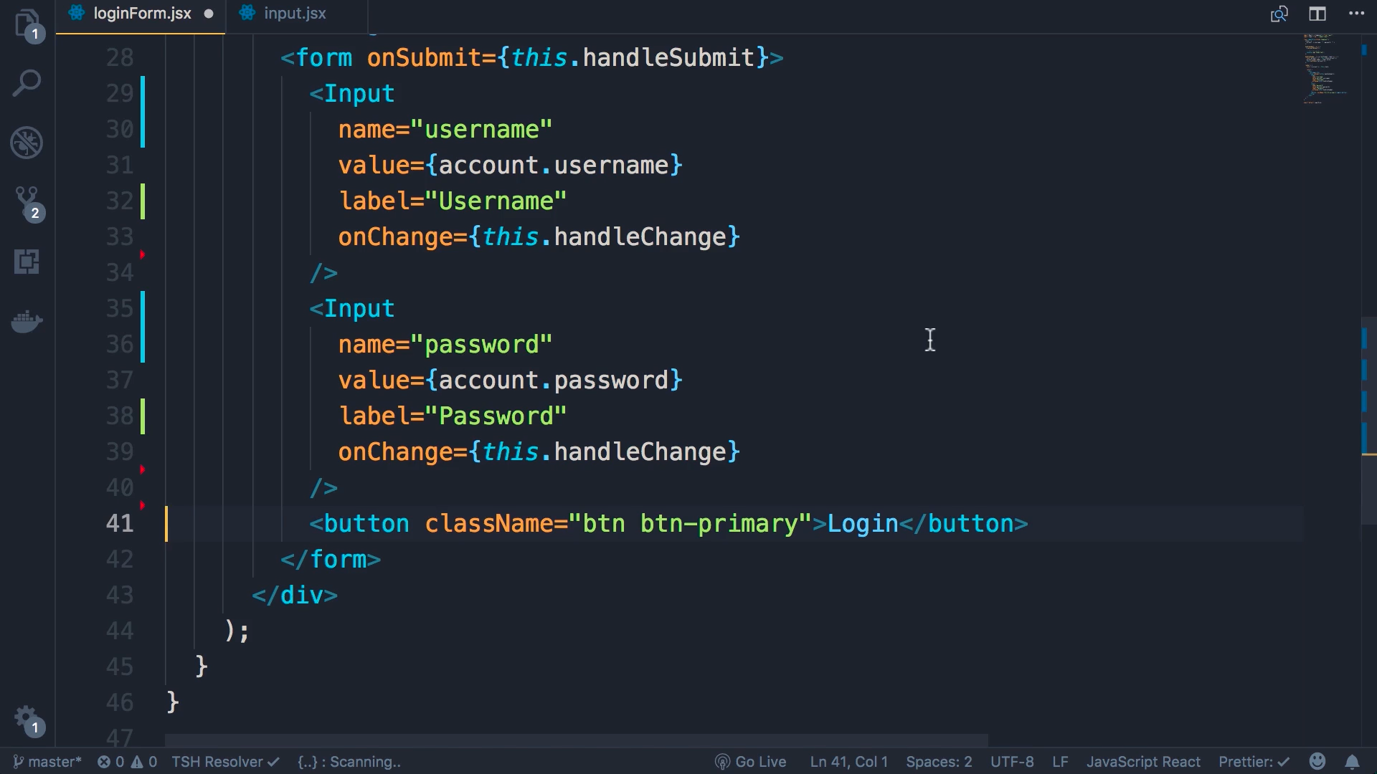
Import input.jsx

